Slide 1
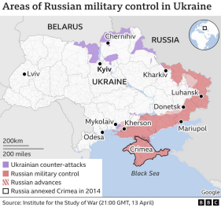
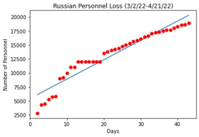
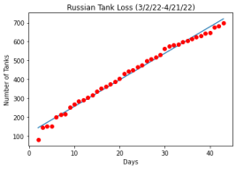
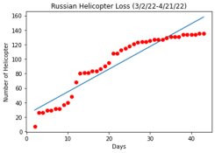
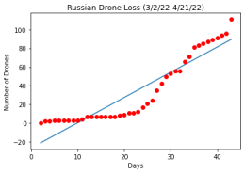

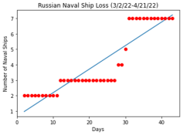
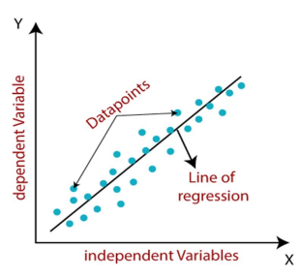
Regression Analysis on the Losses of Russian Military Personnel & Equipment in the Ukraine-Russia Conflict
Highlights
As the war rages further, the personnel and equipment losses are going to increase per day.
Comparing these costs with previous armed invasions carried out by Russia, could give a rough estimate about we can conclude for how much further in future this conflict could drag.
Although there are still many variable to consider, we can see that Russia is still taking considerable losses as this conflict continues.
Author 1, Author 2, Author 3
Background
On 24 February 2022, Russian President Vladimir Putin ordered an invasion of Ukraine by Russian armed forces previously concentrated along the border.
The invasion included attacks across the Belarus Ukraine border and was followed by targeted airstrikes on military buildings in Ukraine.
Correct prediction of future losses with regression analysis could provide insight on the costs involved in continuation of armed conflict.
Looking ahead to a period of 60 - 80 days into this conflict, Russian military forces are expected to lose over 25,000 personnel, over 1200 armored vehicles, and over 500 aircraft.
Data
2022 Ukraine Russia War - Kaggle.com
Daily updates of Russian personnel and equipment loss
Data collected by Petro on Kaggle.com:
Data Scientist, PhD
Lviv, Ukraine
Main source of data:
Armed Forces of Ukraine and Ministry of Defense of Ukraine
Model
Linear regression
Supervised ML algorithm
Uses historical data to predict future numerical values
Although there are still many variable to consider, we can see that Russia is still taking considerable losses as this conflict continues.
Next Steps
Gather information from more sources to perform a more accurate analysis.
Gather expense data on equipment and personnel loss to calculate financial loss.
Compare to when Ukrainian cities were taken over and determine how much more equipment, personnel, and financial loss it took to capture those cities.

